Slide 1
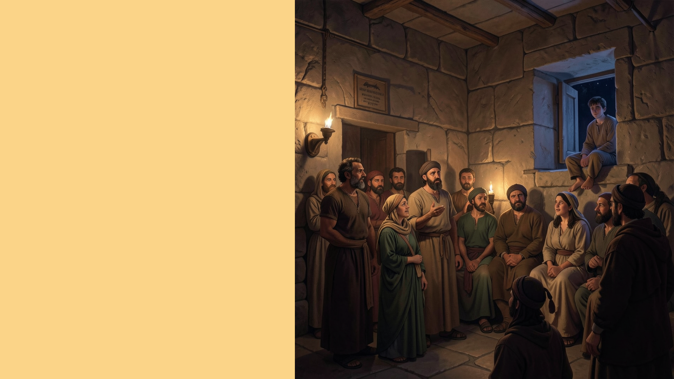
An Eventful Night at Troas
Acts 20:7-12

Slide 2
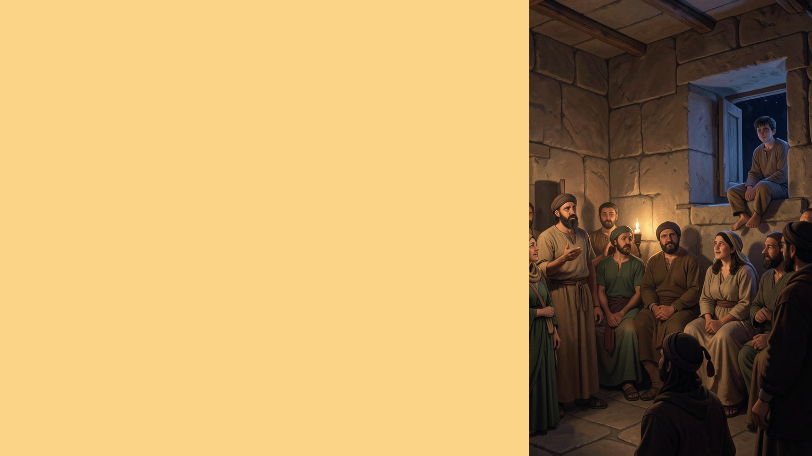
Lessons for Us
The Lord’s Supper (7)
Revelation 1:10; Matthew 7:21
(cf. Mat. 26:26-29; 1 Cor. 11:21-30)
Paul’s Legitimate Apostleship (9-12)
1 Corinthians 4:1-4; 9:1-2; 15:8-10; Acts 28:3-6; 14:14-15

Slide 3
Conclusion
Paul was doing God’s Work!
What About Us?
1 Corinthians 11:1

